Slide 1
Online Cab Booking System

Slide 2

Object Oriented Design
Course code : SE 221
Created by
Submitted to
Suraiya Rahman Sujan
0242310005341004
Erin Jahan Eshita
0242310005341074
Khadiza Begum
0242310005341276
Durjoy Bhowmik
Lecturer
Department of Software Engineering
Daffodil International University

Slide 3
Table of contents
Introduction
Objectives
Methodology
Purpose and scope
Key features
Functionalities
Conclusion

Slide 4

Introduction
The Cab Booking System is a simple application that allows users to register, log in, and book cabs. It aims to streamline the ride-booking process, offering a user-friendly interface where users can check available cabs and book a ride. The system leverages object-oriented programming (OOP) principles like inheritance, encapsulation, abstraction, and polymorphism to model vehicles, bookings, and users effectively.

Slide 5
Objectives
Simplify the process of booking cabs by allowing users to view available vehicles and make reservations.
Implement user management, including registration, login, and logout functionalities.
Demonstrate the use of core OOP concepts in a practical system.
Provide transparent booking and cab management for a smooth user experience.

Slide 6
Methodology
The system is developed using Object-Oriented Programming (OOP) in Java. Key components include:
Vehicle and Cab Classes: Represent cabs with details and availability.
Booking Class: Stores booking details and manages ride reservations.
Cab Booking System Class: Handles the core logic for user registration, login, and cab booking. The system interacts with the user via a menu-driven interface, where users can choose option such as registering, logging in, viewing cabs, and booking rides.

Slide 7
Purpose and scope
The primary purpose of the system is to provide users with an easy way to register, log in, and book cabs for their transportation needs. The system allows users to manage bookings, check available cabs, and track their past rides. It is designed for small-scale use, operating through a text-based interface, and stores data in memory. The future scope includes extending the system with features like database integration, a graphical user interface (GUI), or additional functionalities such as real-time tracking and payment integration.

Slide 8
Key features
User Registration & Login
Cab Availability
Cab Booking
Booking Management
Cab Details
User Logout

Slide 9
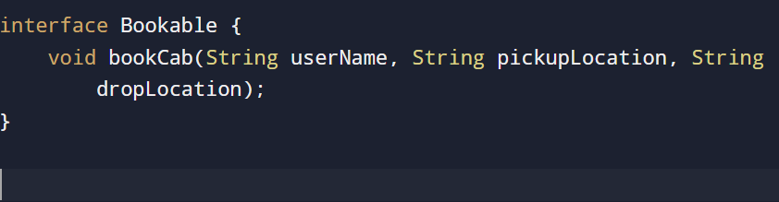
Code Screenshot of functionalities
(Interface for Booking (Bookable)
Functionality : the bookable interface defines the method bookcab(),which is implemented by the cab class to ensure all bookable vehicles follow the same booking process.
OOP CONCEPTS USED:
Interface
Polymorphism

Slide 10
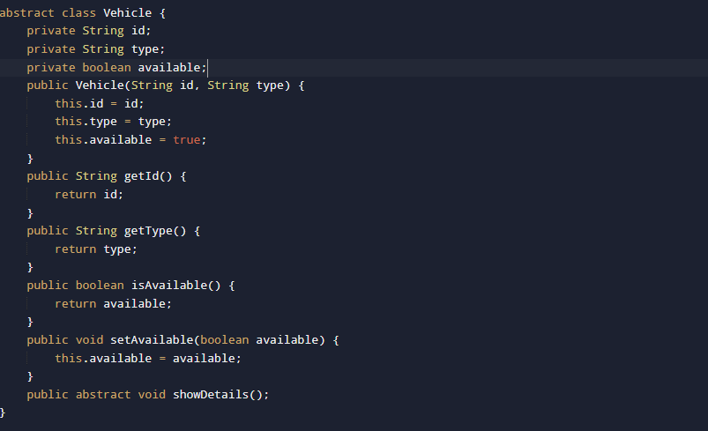
Vehicle Class (Abstract Class)
Functionality :
The vehicle class is an abstract class that represents any type of vehicle(like a cab).it contains attributes like id, type and available status are private accessed via getter and setter methods and includes an abstract method showdetails() for polymorphism.
OOP concepts:
Abstract class
Encapsulation
polymorphism

Slide 11
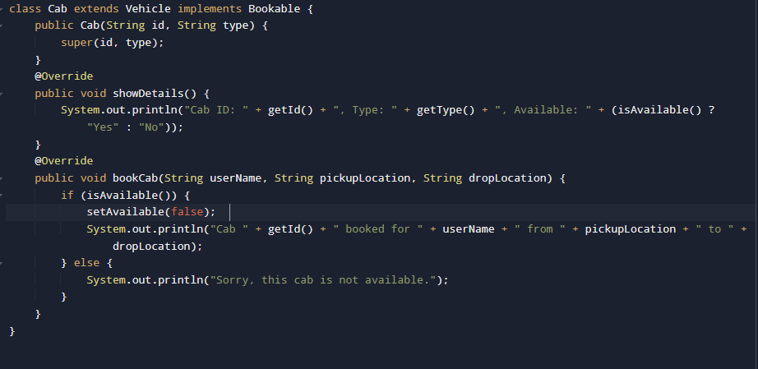
Cab Class (Concrete implementation)
Functionality:
The cab class extends the vehicle class and implements the bookable interface.it defines the behavior of the showdetails() and bookcab() methods for a specific vehicle type (cab).
OOP concepts:
Inheritance
Interface implementation

Slide 12
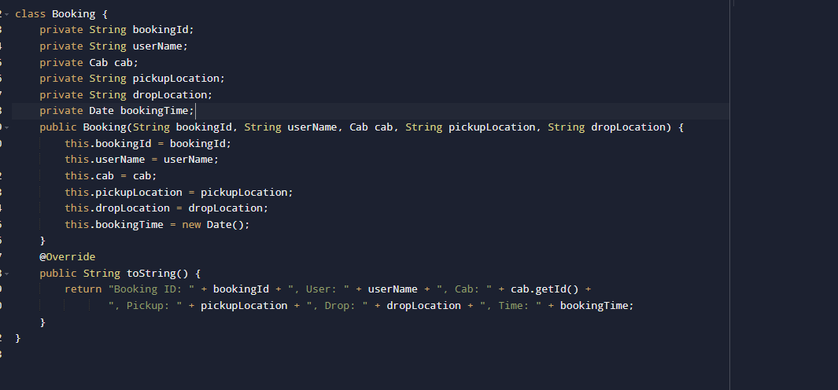
Booking class
Functionality:
The booking class holds the details of a cab booking, such as booking ID, username, cab details, pickup and drop locations, and the booking time.
OOP concepts:
Encapsulation : attributes like bookingId, username and pickuplocation are encapsulated within the class and accessed via methods.

Slide 13
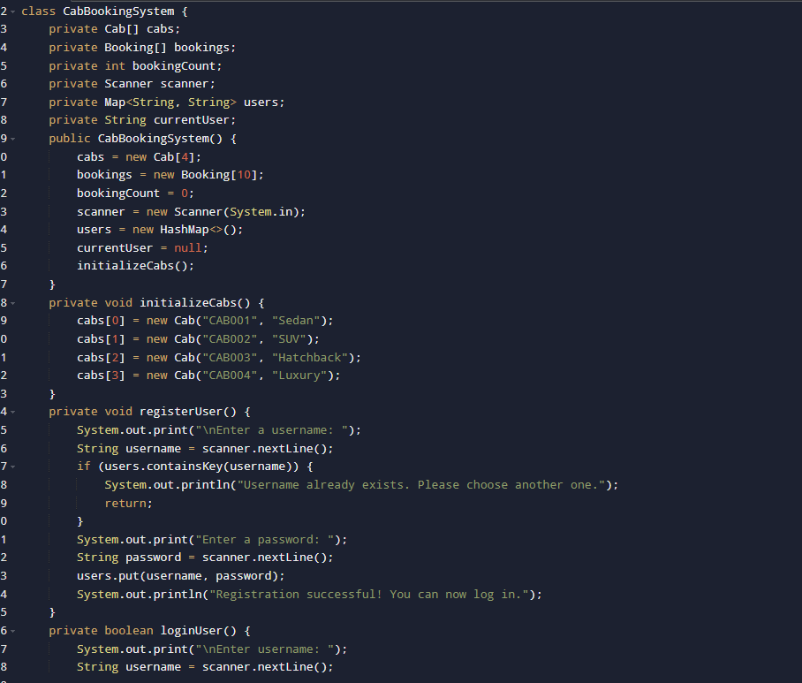
CabBookingSystem Class (Main Controller)
Functionality: This class manages the core logic of the cab booking system. It allows users to register, login, book a cab, view bookings, etc. It interacts with the cab and booking objects.
OOP concepts :
Encapsulation: all system data(like cabs, bookings, users)is encapsulated in the cabBookingSystem class.
Polymorphism: the system uses polymorphism when calling bookcab() on different objects that implement bookable (like cab).

Slide 14
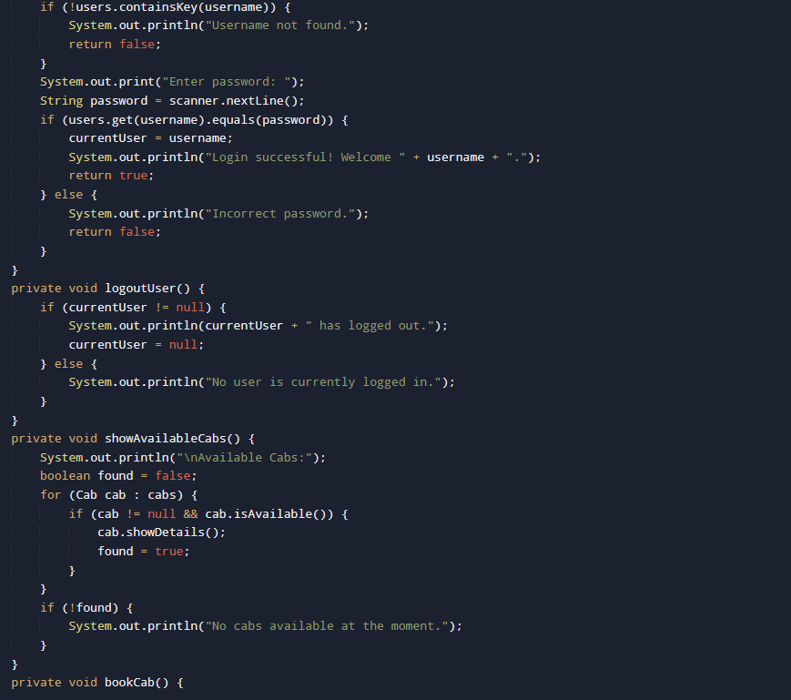
CabBookingSystem Class (Main Controller)

Slide 15
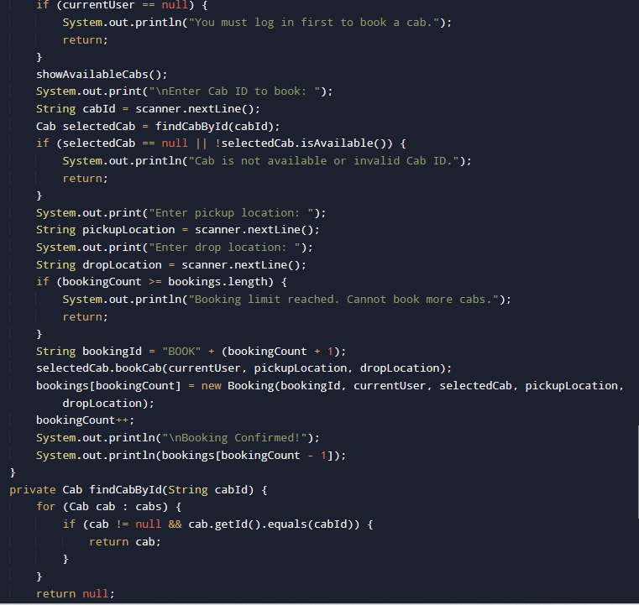
CabBookingSystem Class (Main Controller)

Slide 16
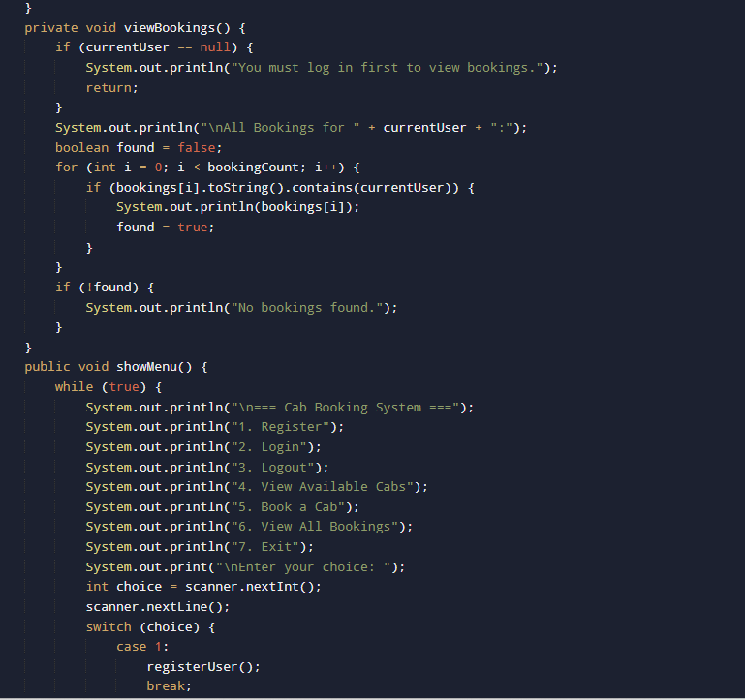
CabBookingSystem Class (Main Controller)

Slide 17
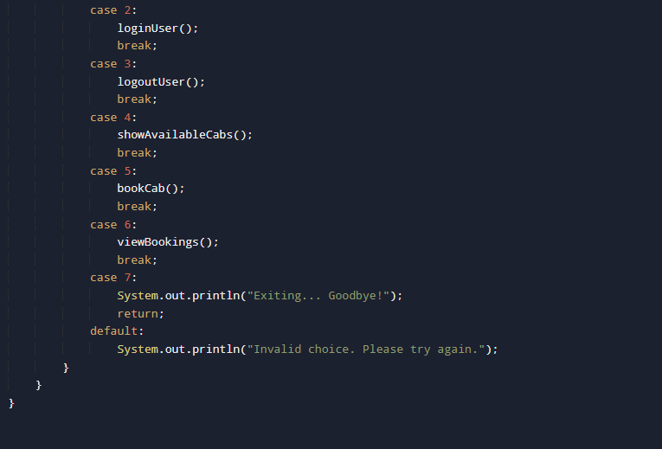
CabBookingSystem Class (Main Controller)

Slide 18
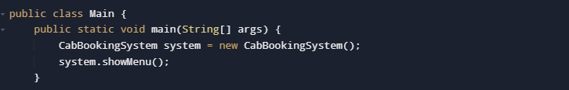
Main class
Functionality: the main class acts as the program entry point.it initializes the cabBookingSystem object and starts the system by calling showMenu()
OOP Concepts :
Encapsulation :interacts with the cabBookingSystem class through the showmenu() method hiding the implementation details.
Abstraction :the main class abstracts away the internal workings of CabBookingSystem ,focusing only on starting the system.
Object creation :it creates an object of the CabBookingSystem (new CabBookingSystem()),showing the core concepts of working with objects in OOP.

Slide 19
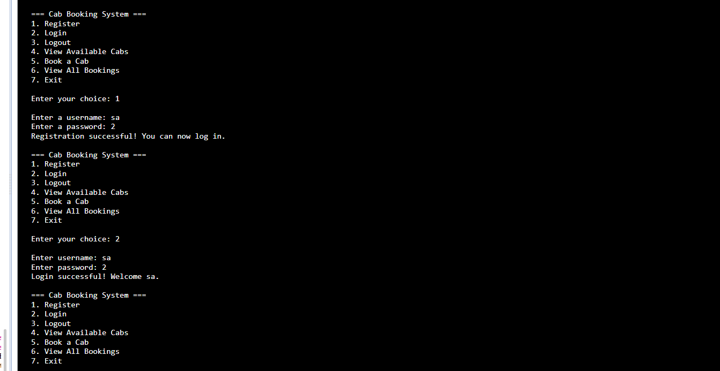
Output of this system

Slide 20
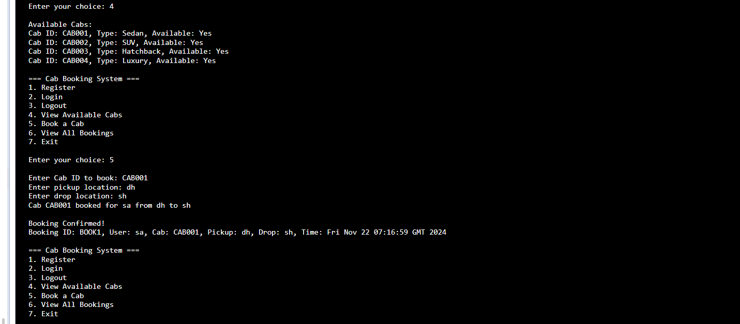
Output of this system

Slide 21
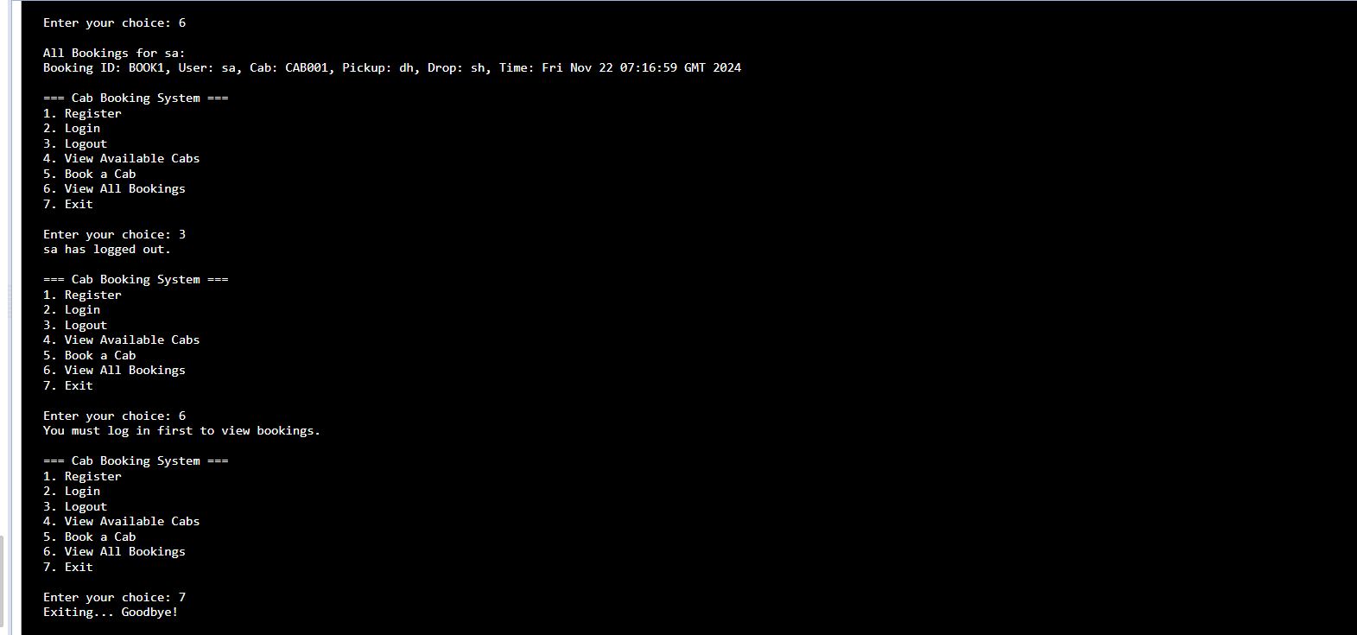
Output of this system

Slide 22
Limitations
The project lacks an intuitive user interface, relying on command-line input instead. It doesn't include features like user profile management, cab maintenance, or notifications. Also, the booking system is limited to a small number of cabs and bookings, making it impractical for larger operations. The absence of security measures like password encryption makes it less secure. Finally, the system doesn't handle concurrency or multiple users interacting simultaneously.

Slide 23
Conclusion
In conclusion, this cab booking system showcases essential features like user registration, login, and cab booking. However, it lacks advanced functionalities such as real-time updates, dynamic pricing, and robust security. The system also has scalability limitations, making it unsuitable for large-scale use. Nonetheless, it provides a good starting point for expanding and enhancing its capabilities.

Slide 24
References
Textbooks : https://open.umn.edu/opentextbooks/textbooks/419
Online tutorial : https://www.w3schools.com/java/ , https://www.geeksforgeeks.org/java/
Online IDE: https://www.programiz.com/java-programming/online-compiler/, https://www.jdoodle.com/online-java-compiler
Project ideas: https://www.geeksforgeeks.org/java-projects/

Slide 25
Thank you

